Slide 1


Snigdha Kinattamittathu Narayanan
18-01-2022

Slide 2

Outline
Executive Summary
Introduction
Methodology
Results
Conclusion
Appendix

Slide 3
Executive Summary
The following methods were used for Data Analysis
Using Web Scrapping and Spacex API, Data was collected
Exploratory Data Analysis including Data wrangling, Data Visualisation using Folium and Dashboard creation using Plotly was done
Machine Learning Prediction was done.
Summary of all results
Public data was collected using various techniques
Using EDA , was able to find the best features for predicting successful launchings
Using Machine learning prediction , different model prediction was done and compared to find the best one with higher accuracy

Slide 4
Introduction
The objective is to evaluate the viability of the new company Space Y to compete with Space X.
Desirable Answers:
By Predicting the successful landings of the first stage, find a way to find the the total cost required
Best place to make the launches

Slide 5

Section 1

Slide 6
Methodology
Executive Summary
Data collection methodology:
Data from Space X was obtained from two sources
Space X API - https://api.spacexdata.com/v4/rockets/
Web Scrapping from https://en.wikipedia.org/wiki/List_of_Falcon/_9/_and_Falcon_Heavy_launches
Perform data wrangling
Collected data was enriched by creating a landing outcome label based on outcome data after summarizing and analyzing features
Perform exploratory data analysis (EDA) using visualization and SQL
Perform interactive visual analytics using Folium and Plotly Dash
Perform predictive analysis using classification models
How to build, tune, evaluate classification models

Slide 7
Executive Summary
•Perform interactive visual analytics using Folium andPlotlyDash
•Perform predictive analysis using classification models
•Data that was collected until this step were normalized, divided in training and test data sets and evaluated by four different classification models, being the accuracy of each model evaluated using different combinations of parameters.

Slide 8
Data Collection
Data sets were collected from Space X API (https://api.spacexdata.com/v4/rockets/) and from Wikipedia (https://en.wikipedia.org/wiki/List_of_Falcon/_9/_and_Falcon_Heavy_launches), using web scraping technics.

Slide 9
Data Collection – SpaceX API
SpaceX offers a public API from where data can be obtained and then used;
•This API was used according to the flowchart beside and then data is persisted.
Github Link - Python-Data-Science/spacex-data-collection.ipynb at main · Snigdha1078/Python-Data-Science · GitHub
Request and parse the SpaceX launch data using the GET request
Filter the Dataframe to only include Falcon 9 launches
Deal with missing values
Copy the changes and save it in csv

Slide 10
Data Collection - Scraping
Few Spacex Data was also available in Wikipedia.
It was extracted using Web Scrapping. The process is explained in the flow chart. BeautifulSoup was used to do the process.
Github Link - Python-Data-Science/Data_Webscrapping.ipynb at main · Snigdha1078/Python-Data-Science · GitHub
Request the Falcon9 Launch Wiki page from its URL
Create a BeautifulSoup object
Extract all column/variable names from the HTML table header
Parse the launch tables into a data frame.

Slide 11
Data Wrangling
Exploratory Data Analysis (EDA) was done to find the patterns in the data and to find the required labels for model prediction.
Then the launches per site, occurrences of each orbit and occurrences of mission outcome per orbit type were calculated.
Finally, the landing outcome label was created from Outcome column.
Github Link - Python-Data-Science/Data_wrangling.ipynb at main · Snigdha1078/Python-Data-Science · GitHub
EDA
Calculations
Output Label Creation

Slide 12
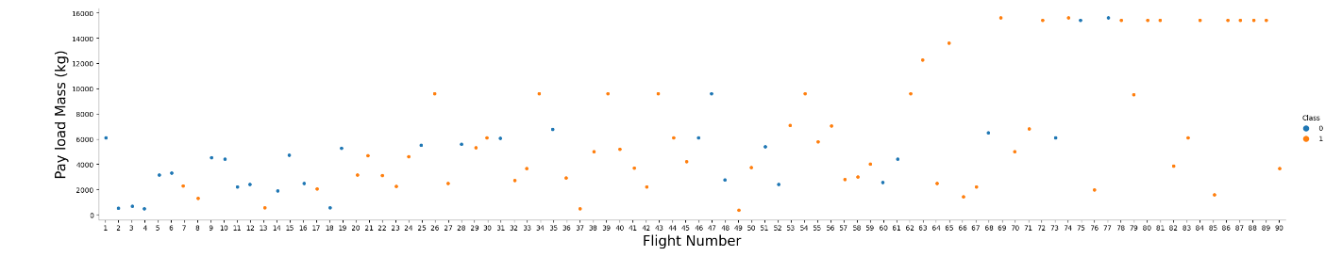
EDA with Data Visualization
To explore data, scatterplots and barplotswere used to visualize the relationship between pair of features:
•Payload Mass X Flight Number, Launch Site X Flight Number, Launch Site X Payload Mass, Orbit and Flight Number, Payload and Orbit
Github Link - Python-Data-Science/Data_Visualization.ipynb at main · Snigdha1078/Python-Data-Science · GitHub

Slide 13
EDA with SQL
The following SQL queries were performed,
Connect to the DB
Display the names of the unique launch sites in the space mission
Display 5 records where launch sites begin with the string 'CCA’
Calculate and display the total payload mass carried by boosters launched by NASA(CRS)
Average payload mass carried by booster version F9 v1.1
List the date when the first successful landing outcome in ground pad was achieved
List the names of the boosters which have success in drone ship and have payload mass greater than 4000 but less than 6000
List the total number of successful and failure mission outcomes
List the names of the booster_versions which have carried the maximum payload mass. Use a subquery
List the failed landing_outcomes in drone ship, their booster versions, and launch site names for in year 2015
Rank the count of landing outcomes (such as Failure (drone ship) or Success (ground pad)) between the date 2010-06-04 and 2017-03-20, in descending order
Github Link - Python-Data-Science/EDA_with_SQL.ipynb at main · Snigdha1078/Python-Data-Science · GitHub

Slide 14
Build an Interactive Map with Folium
Markers, circles, lines and marker clusters were used with Folium Maps
Markers indicate points like launch sites;
Circles indicate highlighted areas around specific coordinates, like NASA Johnson Space Center;
Marker clusters indicates groups of events in each coordinate, like launches in a launch site; and
Lines are used to indicate distances between two coordinates.
Github Link - Python-Data-Science/Dashboard.ipynb at main · Snigdha1078/Python-Data-Science · GitHub

Slide 15
Build a Dashboard with Plotly Dash
The following graphs and plots were used to visualize data
Percentage of launches by site
Payload range
This combination allowed to quickly analyze the relation between payloads and launch sites, helping to identify where is best place to launch according to payloads.
Github link - Python-Data-Science/spacex_dash_app.py at main · Snigdha1078/Python-Data-Science · GitHub

Slide 16
Predictive Analysis (Classification)
Four classification models were compared: logistic regression, support vector machine, decision tree and k nearest neighbors.
Github Link - Python-Data-Science/SpaceX_Machine_Learning_Prediction.ipynb at main · Snigdha1078/Python-Data-Science · GitHub
Data Preparation and Standarization
Test Each models with hyperparameter tuning
Comparing each models results

Slide 17
Results
Exploratory data analysis results:
Space X uses 4 different launch sites;
The first launches were done to Space X itself and NASA;
The average payload of F9 v1.1 booster is 2,928 kg;
The first success landing outcome happened in 2015 fiver year after the first launch;
Many Falcon 9 booster versions were successful at landing in drone ships having payload above the average;
Almost 100% of mission outcomes were successful;
Two booster versions failed at landing in drone ships in 2015: F9 v1.1 B1012 and F9 v1.1 B1015;
The number of landing outcomes became as better as years passed.

Slide 18
Using interactive analytics was possible to identify that launch sites use to be in safety places, near sea, for example and have a good logistic infrastructure around.
Most launches happens at east cost launch sites.

Slide 19
Predictive Analysis showed that Decision Tree Classifier is the best model to predict successful landings, having accuracy over 87% and accuracy for test data over 94%.

Slide 20

Section 2

Slide 21
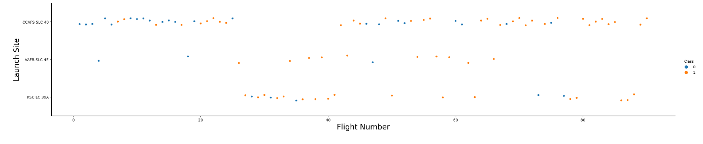
Flight Number vs. Launch Site
According to the plot above, it’s possible to verify that the best launch site is CCAF5 SLC 40, where most of recent launches were successful
And then comes In second place VAFB SLC 4E and third place KSC LC 39A;

Slide 22
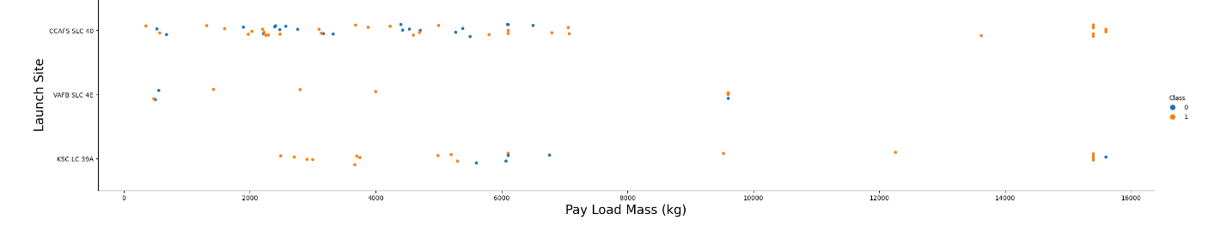
Payload vs. Launch Site
Payloads over 9,000kg (about the weight of a school bus) have excellent success rate;
Payloads over 12,000kg seems to be possible only on CCAFS SLC 40 and KSC LC 39A launch sites.

Slide 23
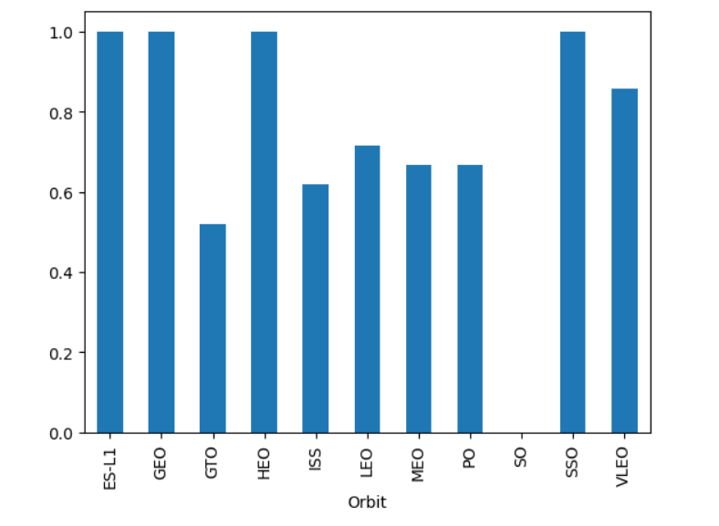
Success Rate vs. Orbit Type
The biggest success rate orbits are ES-L1 , GEO , HEO , SSO
Success rates for GTO , ISS, MEO and PO are comparatively less.

Slide 24
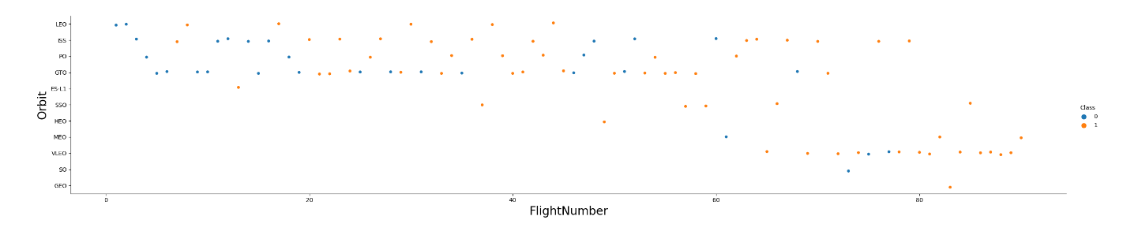
Flight Number vs. Orbit Type
IN GTO orbit , there is no relationship between the flight number while in LEO success appears to be related the flight number
All the orbits have improved the success rate over time.

Slide 25
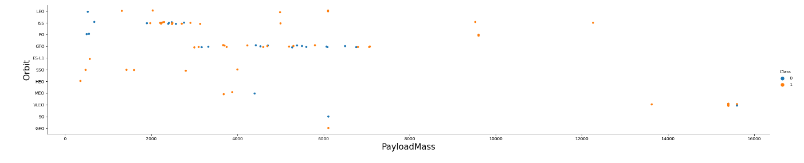
Payload vs. Orbit Type
With heavy payloads the successful landing or positive landing rate are more for Polar,LEO and ISS.
ISS orbit has the widest range of payload and a good rate of success;
GTO we cannot distinguish this well as both positive landing rate and negative landing(unsuccessful mission) are both there here

Slide 26
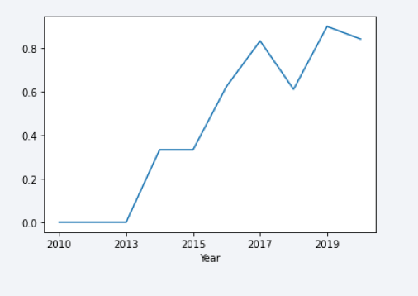
Launch Success Yearly Trend
Success rate started increasing in 2013 and kept until 2020
The growths in the first three years were flat .

Slide 27
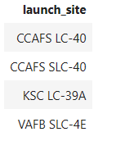
All Launch Site Names
There are 4 main launch sites
From the data , DISTINCT launch_sites were selected to obtain the results.

Slide 28
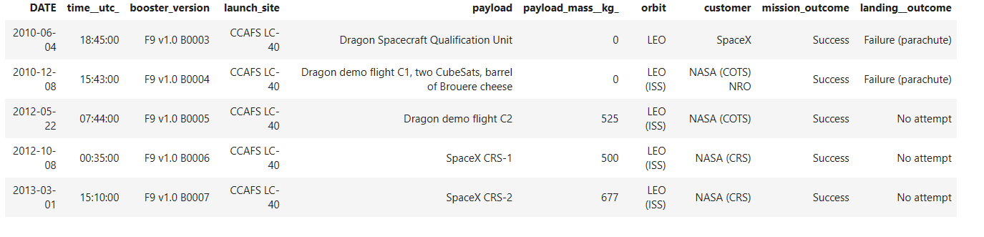
Launch Site Names Begin with 'CCA'
Records were launc sites begin with ‘CCA’
The result was obtained by selecting launch_site where WHERE clause with LIKE ‘CCA%’ is used

Slide 29
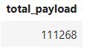
Total Payload Mass
The total payload mass carried by boosters launched by NASA(CRS):
Total payload calculated above, by summing all payloads whose codes contain ‘ CRS’, which corresponds to NASA.

Slide 30
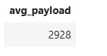
Average Payload Mass by F9 v1.1
The average payload mass carried by booster version F9 v1.1
Filtering data by the booster version above and calculating the average payload mass we obtained the value of 2,928 kg.

Slide 31
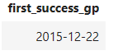
First Successful Ground Landing Date
The dates of the first successful landing outcome on ground pad are
By filtering data by successful landing outcome on ground pad and getting the minimum value for date it’s possible to identify the first occurrence, that happened on 12/22/2015.

Slide 32
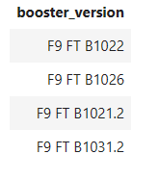
Successful Drone Ship Landing with Payload between 4000 and 6000
The names of boosters which have successfully landed on drone ship and had payload mass greater than 4000 but less than 6000 are

Slide 33
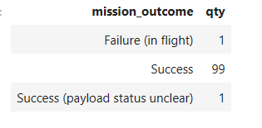
Total Number of Successful and Failure Mission Outcomes
The total number of successful and failure mission outcomes
Grouping mission outcomes and counting records for each group led us to the summary above.

Slide 34
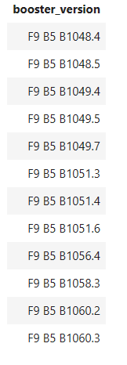
Boosters Carried Maximum Payload
The names of the booster which have carried the maximum payload mass are

Slide 35
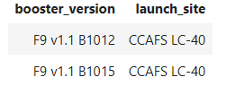
2015 Launch Records
The failed landing_outcomes in drone ship, their booster versions, and launch site names for in year 2015
Both the failed outcomes were at CCAFS LC-40 launch site.

Slide 36
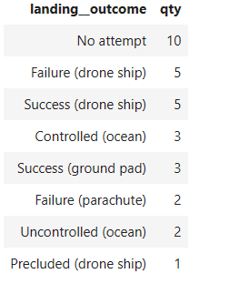
Rank Landing Outcomes Between 2010-06-04 and 2017-03-20
Ranking the count of landing outcomes (such as Failure (drone ship) or Success (ground pad)) between the date 2010-06-04 and 2017-03-20, in descending order
No attempt values must also be taken into account.

Slide 37

Section 3

Slide 38
All Launch Sites
All the launch sites are near the sea area.

Slide 39
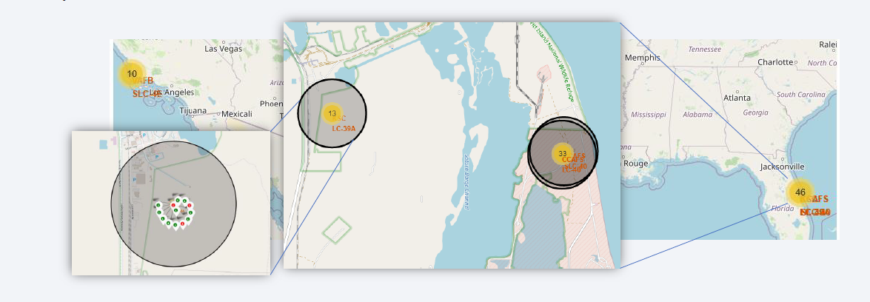
Launch Outcome
For KSC LC-39A
Green indicates success and red indicates failure of launches.

Slide 40
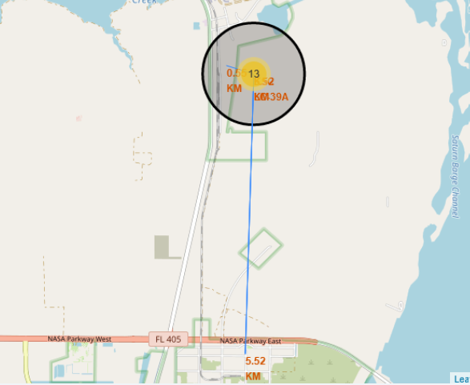
Launch Site Proximities
KSC has good proximities rail road and road while away from the main areas where people live.

Slide 41

Section 4

Slide 42
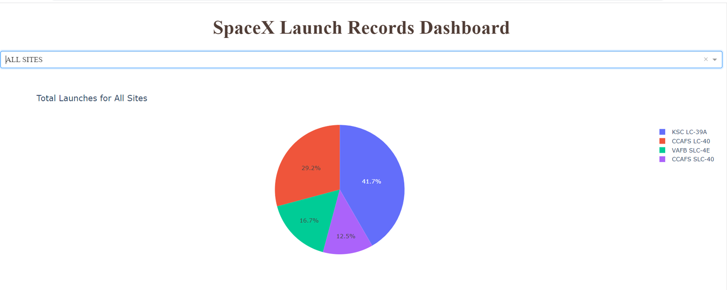
Launch Success
Launch sites play a major role in success or failure of a mission.

Slide 43
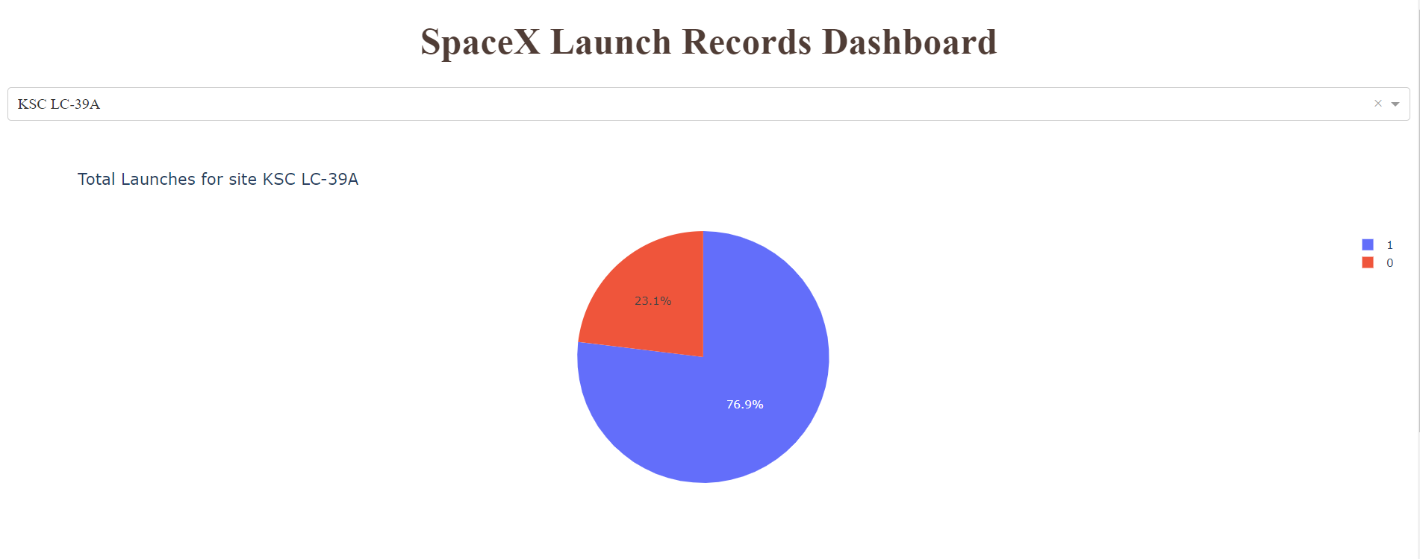
KSC LC-39A Launch Success
Almost 77% of the launches are successful in this launch site.

Slide 44
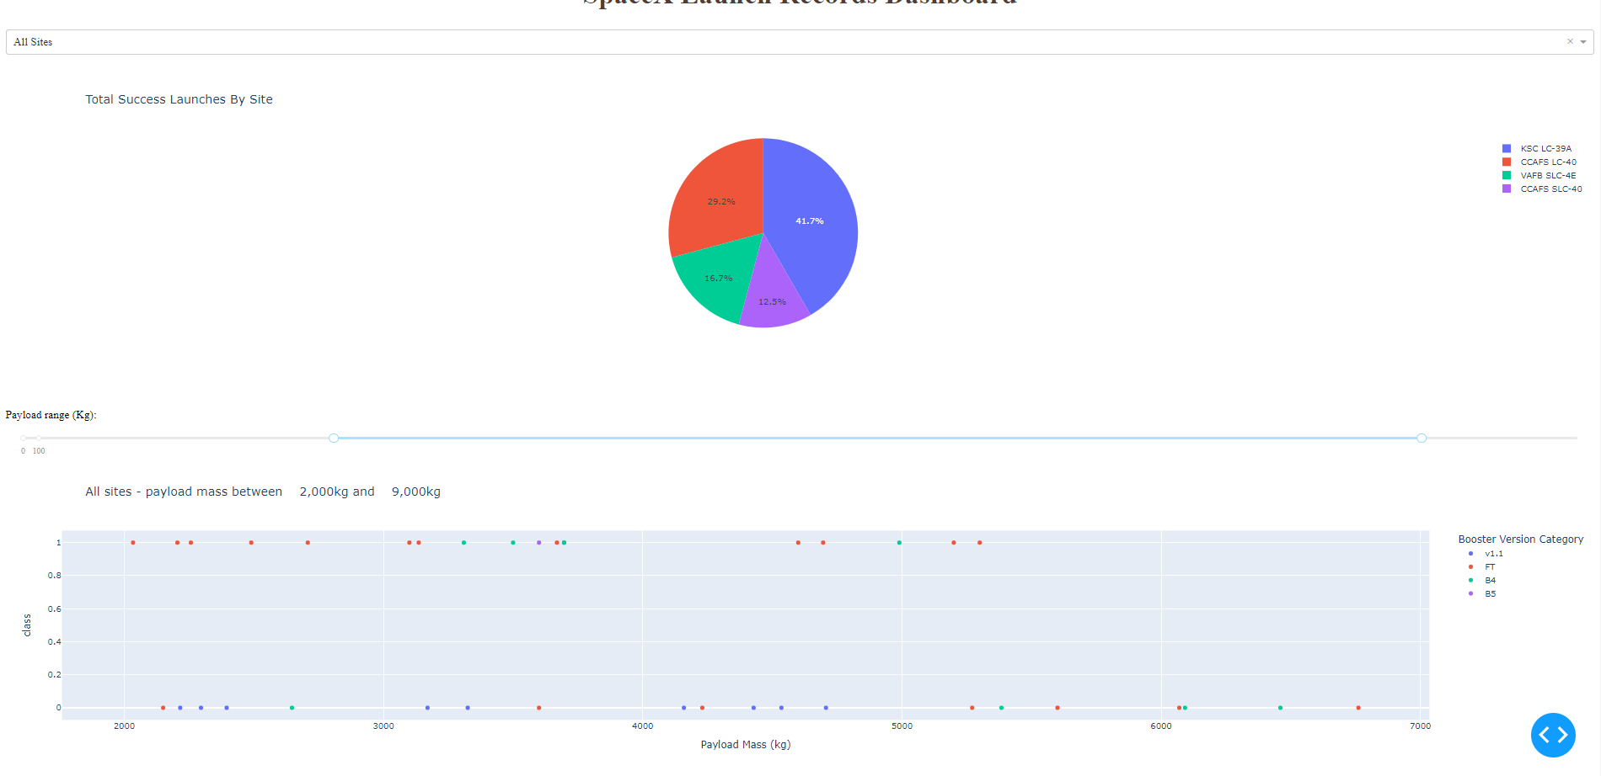
Payload vs. Launch Outcome
Payloads under 6000kg with FT boosters is a successful combination that can be considered.

Slide 45

Section 5

Slide 46
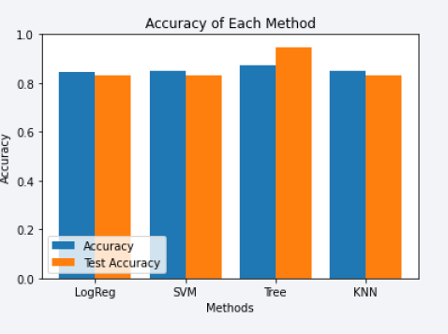
Classification Accuracy
Four classification models were tested,and their accuracies are plotted beside;
Decision Tree classifier has the highest accuracy more than 87%

Slide 47
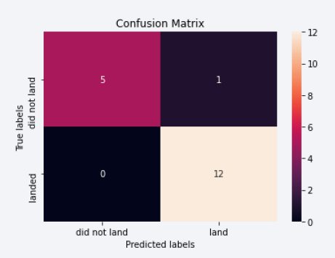
Confusion Matrix
Below is the confusion matrix of Decision Tree classifier

Slide 48
Conclusions
Data was analysied using different techniques and visualized using Dashboard and plotly
KSC LC-39A looks to be the best launch site with almost 77% success.
Launches above 7000kg are less risky , launches under 6000kg with FT boosters can be successful.
Best classifier with more than 85% accuracy is Decision Tree Classifier.
DTC can be used to predict successful landing outcomes.

Slide 49
Appendix
None of the folium maps are showing in Github hence screenshots are provided.

Slide 50


